Slide 1

Importance of wind in fire scenarios based on coupled simulations of an open car park
Bartosz Miechówka

Slide 2
Who am I?
Bachelor of Fire Protection Engineering at MSFS Warsaw (2017-2021)
Master of Fire Protection Engineering at MSFW Warsaw (2021-2023)
Grant student at ITB Warsaw (01.2022 – present)

Slide 3
Why this topic?
Importance of wind in fire scenarios based on coupled simulations of an open car park

Slide 4
Recent car parks fires
City | Number of cars | Date
Marsta, Sweden | 200 | 26.08.2021
Warsaw, Poland | 50 | 16.10.2020
Stavanger, Norway | 300 | 7.01.2020
Cork, Ireland | 60 | 31.08.2019
Nowy York, USA | 120 | 17.09.2018
Liverpool, UK | 1150 | 31.12.2017

Slide 5
What is an open car park?
According to polish regulations:
Open car park is a garage with two parallel walls open to the environment at at least 35% of its area. This condition is calculated separately for every storey.
Distance between open walls can’t be bigger than 100 meters.

Slide 6
What are the benefits?
No need to install mechanical ventilation.
If last parking level is not higher than 25 m from ground and no rooms are above it, than building can be build in class D fire resistance.

Slide 7
Aim and scope of the work

Slide 8
The aim of the work
Primary aims:
Determine the effect of wind on building fires;
Set up risk-based framework used for ecaluation of building safety.
Secondary aims:
Determine the effect of wind on larg scame experiments;
Confronting polish buildings fire protection regulations.

Slide 9
Effect of wind on building fires
The main goal of this aim is to answer this two questions:
What wind?
What fire?
Those questions leads to follow-up ones like:
Does velocity matter? Does angle matters?
How big or how small fires can be affected by wind?

Slide 10
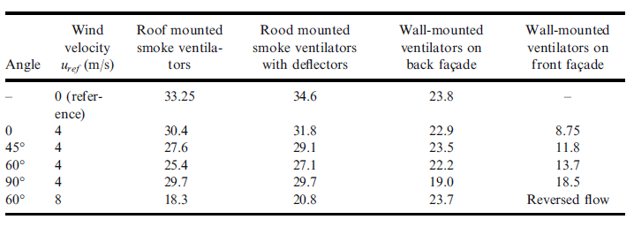
Risk-based framework
The main goal is to improve framework defined in “Wind and Fire Coupled Modelling” parts 1 and 2 by Węgrzyński and Lipiecki.
Updated framework could result in new research possibilities for technical solutions and their improvement in regards to wind effects.

Slide 11
Large scale experiments
The main goal is to determine the effect of various wind conditions on large scale building fire experiments.
Conducting large scale fire experiments in expensive and scarce, understanding of what uncertainty is involved to the experiment due to exposure of wind is crucial.
The objective is to determine the maximum wind velocity, at witch its effect are negligible to the fire.

Slide 12
Polish regulations
The main goal here is confronting polish regulations about fire safe of open car parks and conclude if they should be changed or not.

Slide 13
The scope of the work
Acquire data about:
Number and type of cars;
Number of car park spaces;
Number of car fires;
Car fire tests;
Wind specifics;
Calculate probability of fire;
Create computational models;
Calculate probable fire scenarios;
Run simulations;
Validate method in aerodynamic tunel;
Form conclusions.

Slide 14
Formed hypothesis
All wind conditions affect fire outcomes to some degree. Above a particular threshold value of wind velocity, these effects must be considered as significant.

Slide 15
Data about cars
Data obtained from Central Statistical Office.
Year | <1400kg | 1400-1650 kg | 1650-1900 kg | >1900kg | OVR
2017 | 271039 | 257322 | 307693 | 425749 | 1261803
2018 | 270542 | 262520 | 333687 | 466174 | 1332923
2019 | 269280 | 264530 | 355972 | 503436 | 1393218
Avg. Number of cars | 270287 | 261457 | 332451 | 465120 | 1393218
Avg. % | 20.4% | 19.7% | 25.0% | 34.9% | 100%

Slide 16
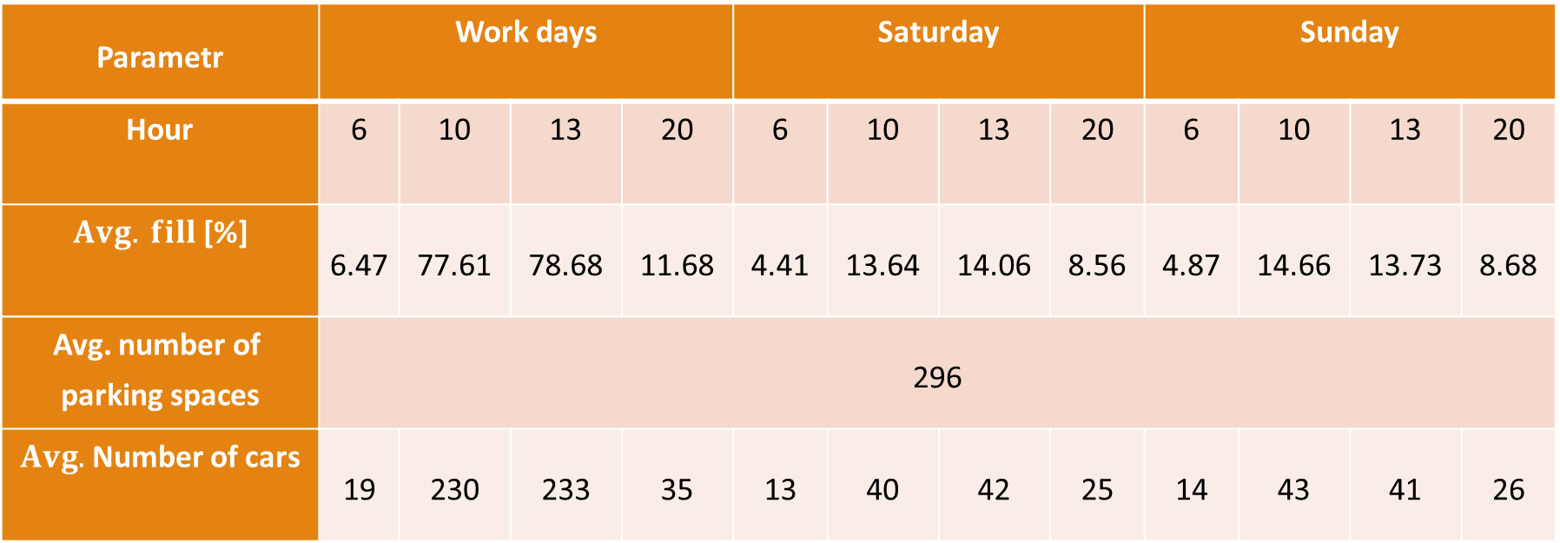
Data about parking spaces
Parametr | Work days |  |  |  | Saturday |  |  |  | Sunday
Hour | 6 | 10 | 13 | 20 | 6 | 10 | 13 | 20 | 6 | 10 | 13 | 20
$$Avg. fill \text{[\%]}$$ | 6.47 | 77.61 | 78.68 | 11.68 | 4.41 | 13.64 | 14.06 | 8.56 | 4.87 | 14.66 | 13.73 | 8.68
Avg. $\text{number} \text{of} \text{parking} \text{spaces}$ | 296
$Avg.$ Number of cars | 19 | 230 | 233 | 35 | 13 | 40 | 42 | 25 | 14 | 43 | 41 | 26

Slide 17
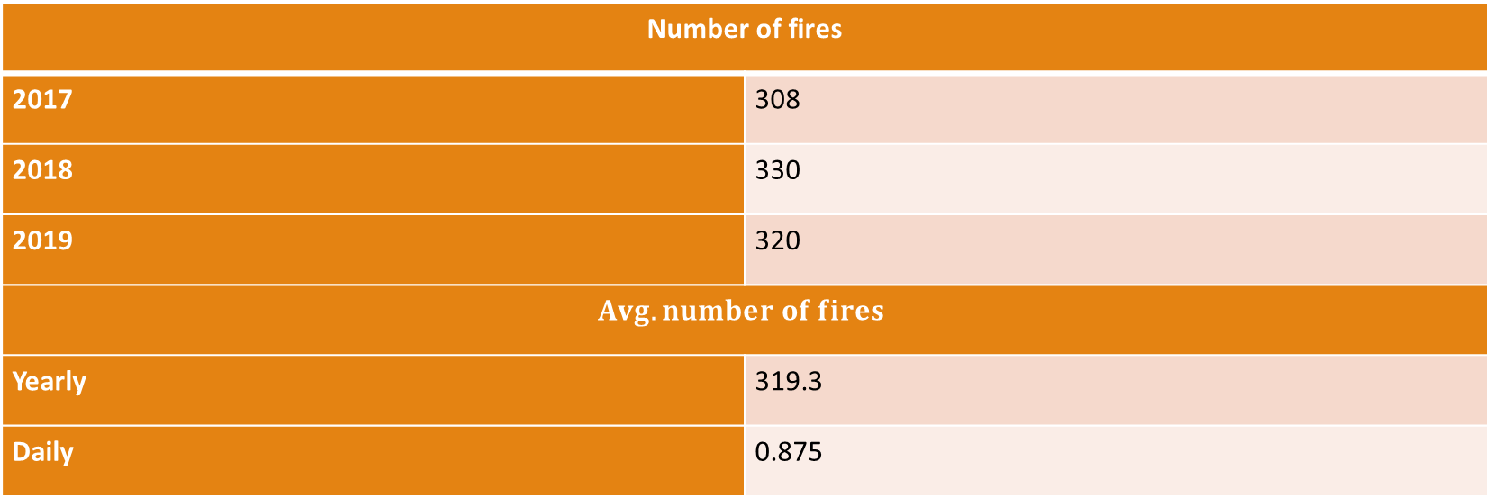
Data about car fires
Data about car fires collected from city headquarters of State Fire Service in Warsaw.
Number of fires
2017 | 308
2018 | 330
2019 | 320
$$Avg. number of fires$$
Yearly | 319.3
Daily | 0.875

Slide 18
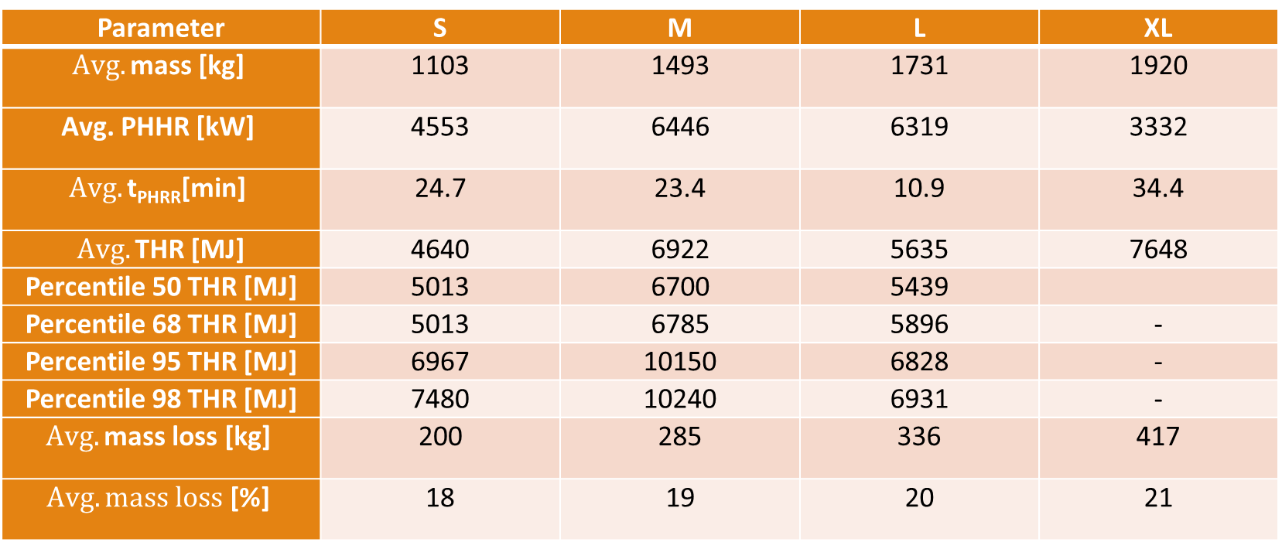
Data about fire test results
Parameter | S | M | L | XL
$$Avg. \text{mass}\text{ [}\text{kg}\text{]}$$ | 1103 | 1493 | 1731 | 1920
$$\text{Avg}\text{. }\text{PHHR}\text{ [}\text{kW}\text{]}$$ | 4553 | 6446 | 6319 | 3332
$$Avg. \text{t}\text{PHRR}\text{[}\text{min}\text{]}$$ | 24.7 | 23.4 | 10.9 | 34.4
$Avg. \text{THR}$ [MJ] | 4640 | 6922 | 5635 | 7648
Percentile 50 THR [MJ] | 5013 | 6700 | 5439
Percentile 68 THR [MJ] | 5013 | 6785 | 5896 | -
Percentile 95 THR [MJ] | 6967 | 10150 | 6828 | -
Percentile 98 THR [MJ] | 7480 | 10240 | 6931 | -
$$Avg. \text{mass} \text{loss}\text{ [}\text{kg}\text{]}$$ | 200 | 285 | 336 | 417
$$Avg. mass loss\text{ [\%]}$$ | 18 | 19 | 20 | 21

Slide 19
Data about wind
After reviewing several articles about wind modeling, conclusions were driven out:
Velocity:
For most realistic approach velocities of 3 m/s and 5 m/s were chosen. Winds 3 m/s cover 2/3 of country and winds 5 m/s cover 1/3 of country. For research purposes winds such as 1, 2 and 7 were considered.
Angles:
According to studies of computational fluid dynamics for urban areas by Blocken the domain were divided every 30º. Acquired angles: 0, 30º, 60º, 90º, 120º, 150º, 180º, 210º, 240º, 270º, 300º, 330º.

Slide 20
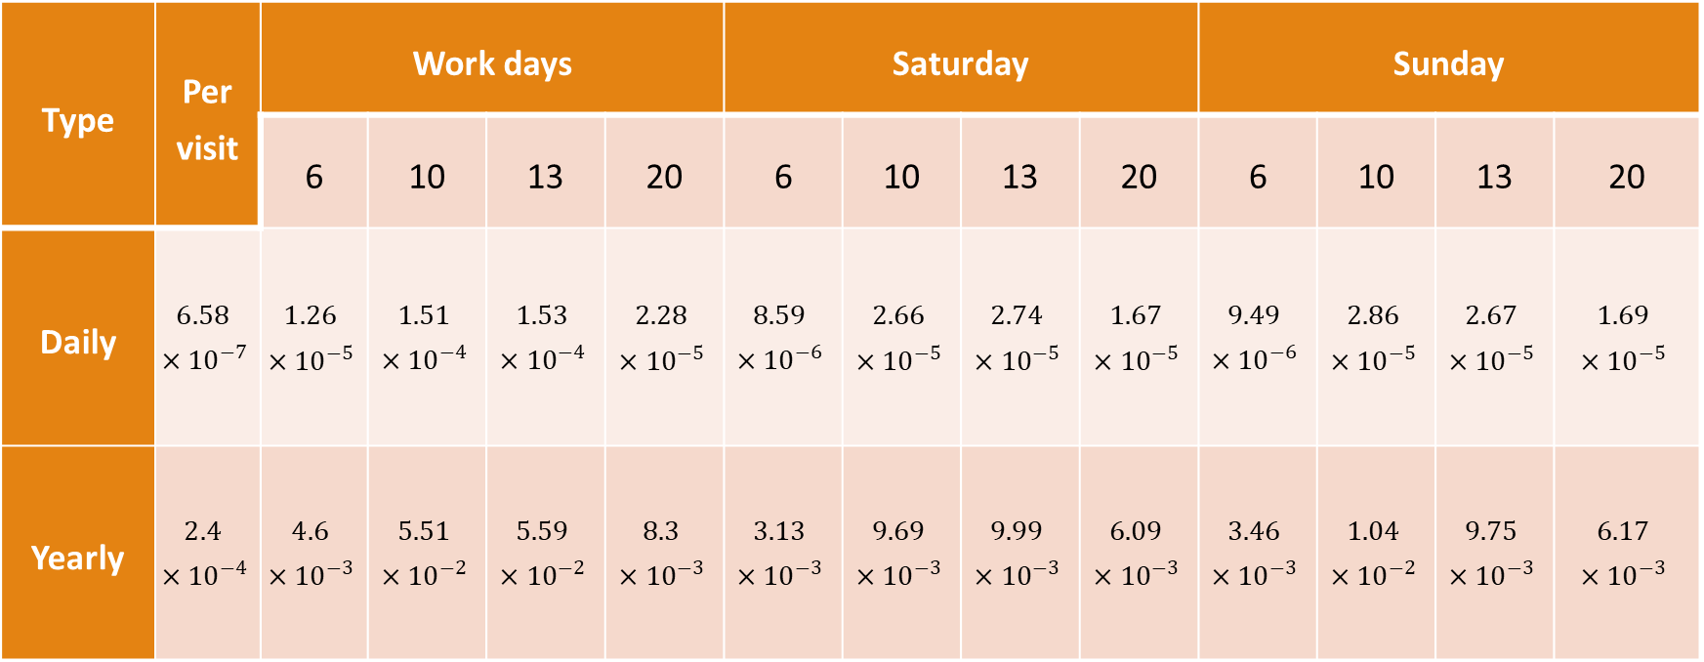
Calculated probability of fire
Type | Per visit | Work days |  |  |  | Saturday |  |  |  | Sunday
 |  | 6 | 10 | 13 | 20 | 6 | 10 | 13 | 20 | 6 | 10 | 13 | 20
Daily | $$6.58×{10}^{−7}$$ | $$1.26×{10}^{−5}$$ | $$1.51×{10}^{−4}$$ | $$1.53×{10}^{−4}$$ | $$2.28×{10}^{−5}$$ | $$8.59×{10}^{−6}$$ | $$2.66×{10}^{−5}$$ | $$2.74×{10}^{−5}$$ | $$1.67×{10}^{−5}$$ | $$9.49×{10}^{−6}$$ | $$2.86×{10}^{−5}$$ | $$2.67×{10}^{−5}$$ | $$1.69×{10}^{−5}$$
Yearly | $$2.4×{10}^{−4}$$ | $$4.6×{10}^{−3}$$ | $$5.51×{10}^{−2}$$ | $$5.59×{10}^{−2}$$ | $$8.3×{10}^{−3}$$ | $$3.13×{10}^{−3}$$ | $$9.69×{10}^{−3}$$ | $$9.99×{10}^{−3}$$ | $$6.09×{10}^{−3}$$ | $$3.46×{10}^{−3}$$ | $$1.04×{10}^{−2}$$ | $$9.75×{10}^{−3}$$ | $$6.17×{10}^{−3}$$

Slide 21
Computational model
Model created for this project contains two domains:
Inner domain:
5 level open car park. Dimensions 32m x 53,4m x 16,5m
Outer domain:
Area of Ksawerow district, Warsaw. 840 m in diameter.

Slide 22
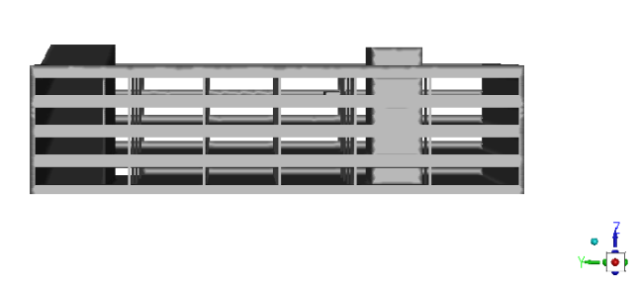
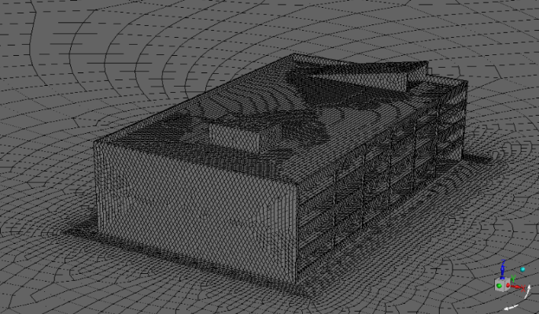
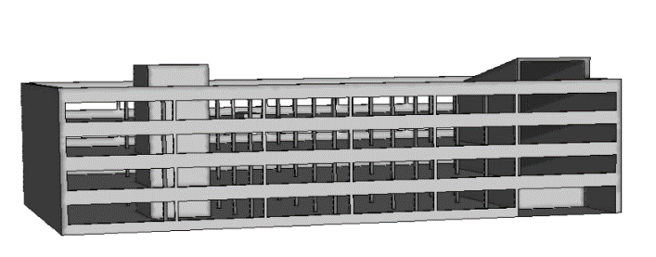
Inner domain

Slide 23
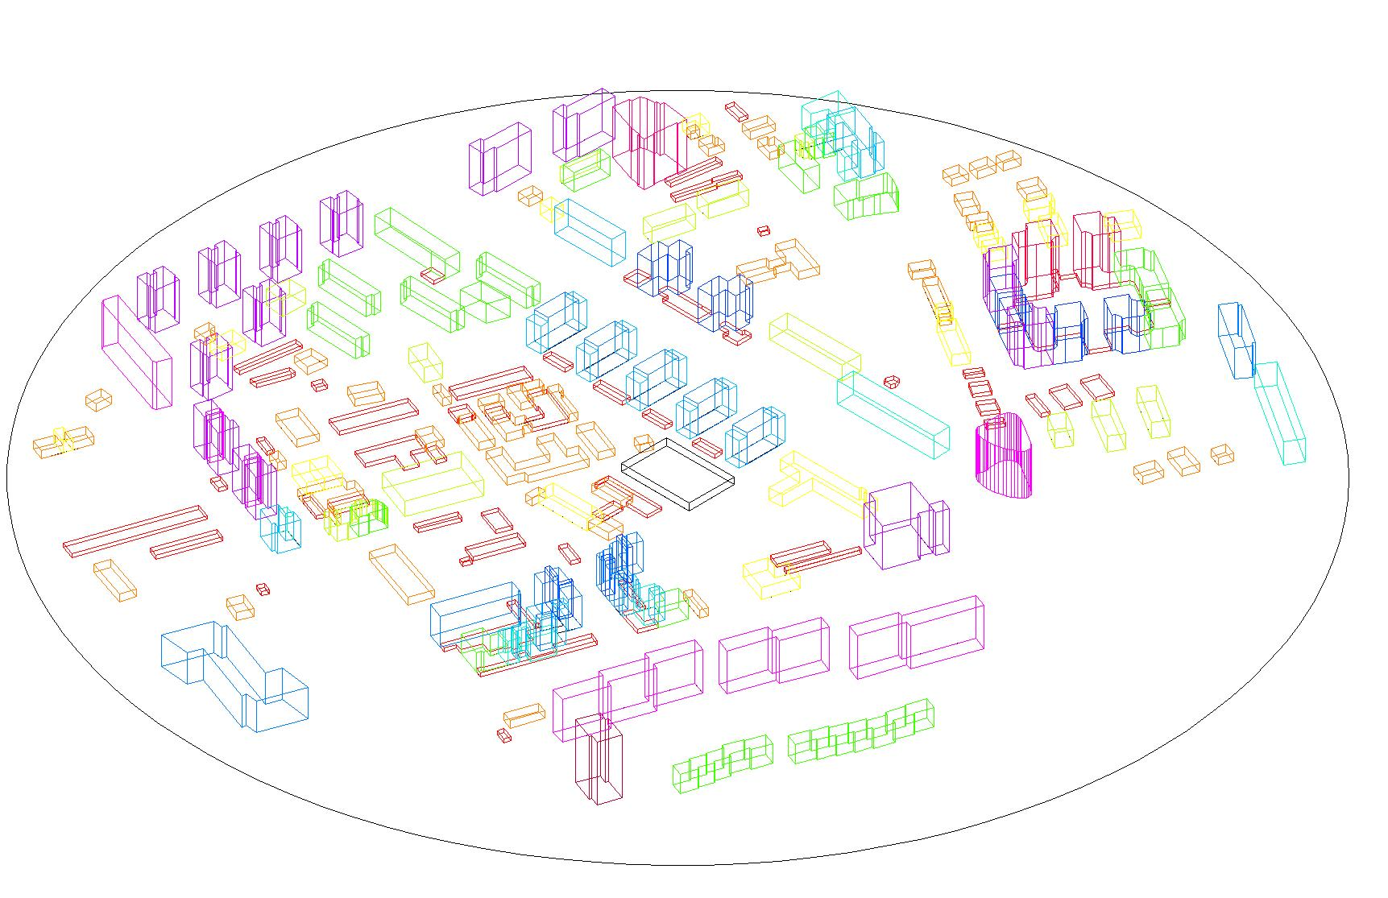
Outer domain

Slide 24
Early simulations
Simulations for cases 4 MW with wind velocity 3 m/s and 5 m/s and 6 MW with wind velocity 3 m/s were calculated.
Fire was placed on 4th level, parking space closes to evacuation staircase.

Slide 25
Example results of simulations

Slide 26
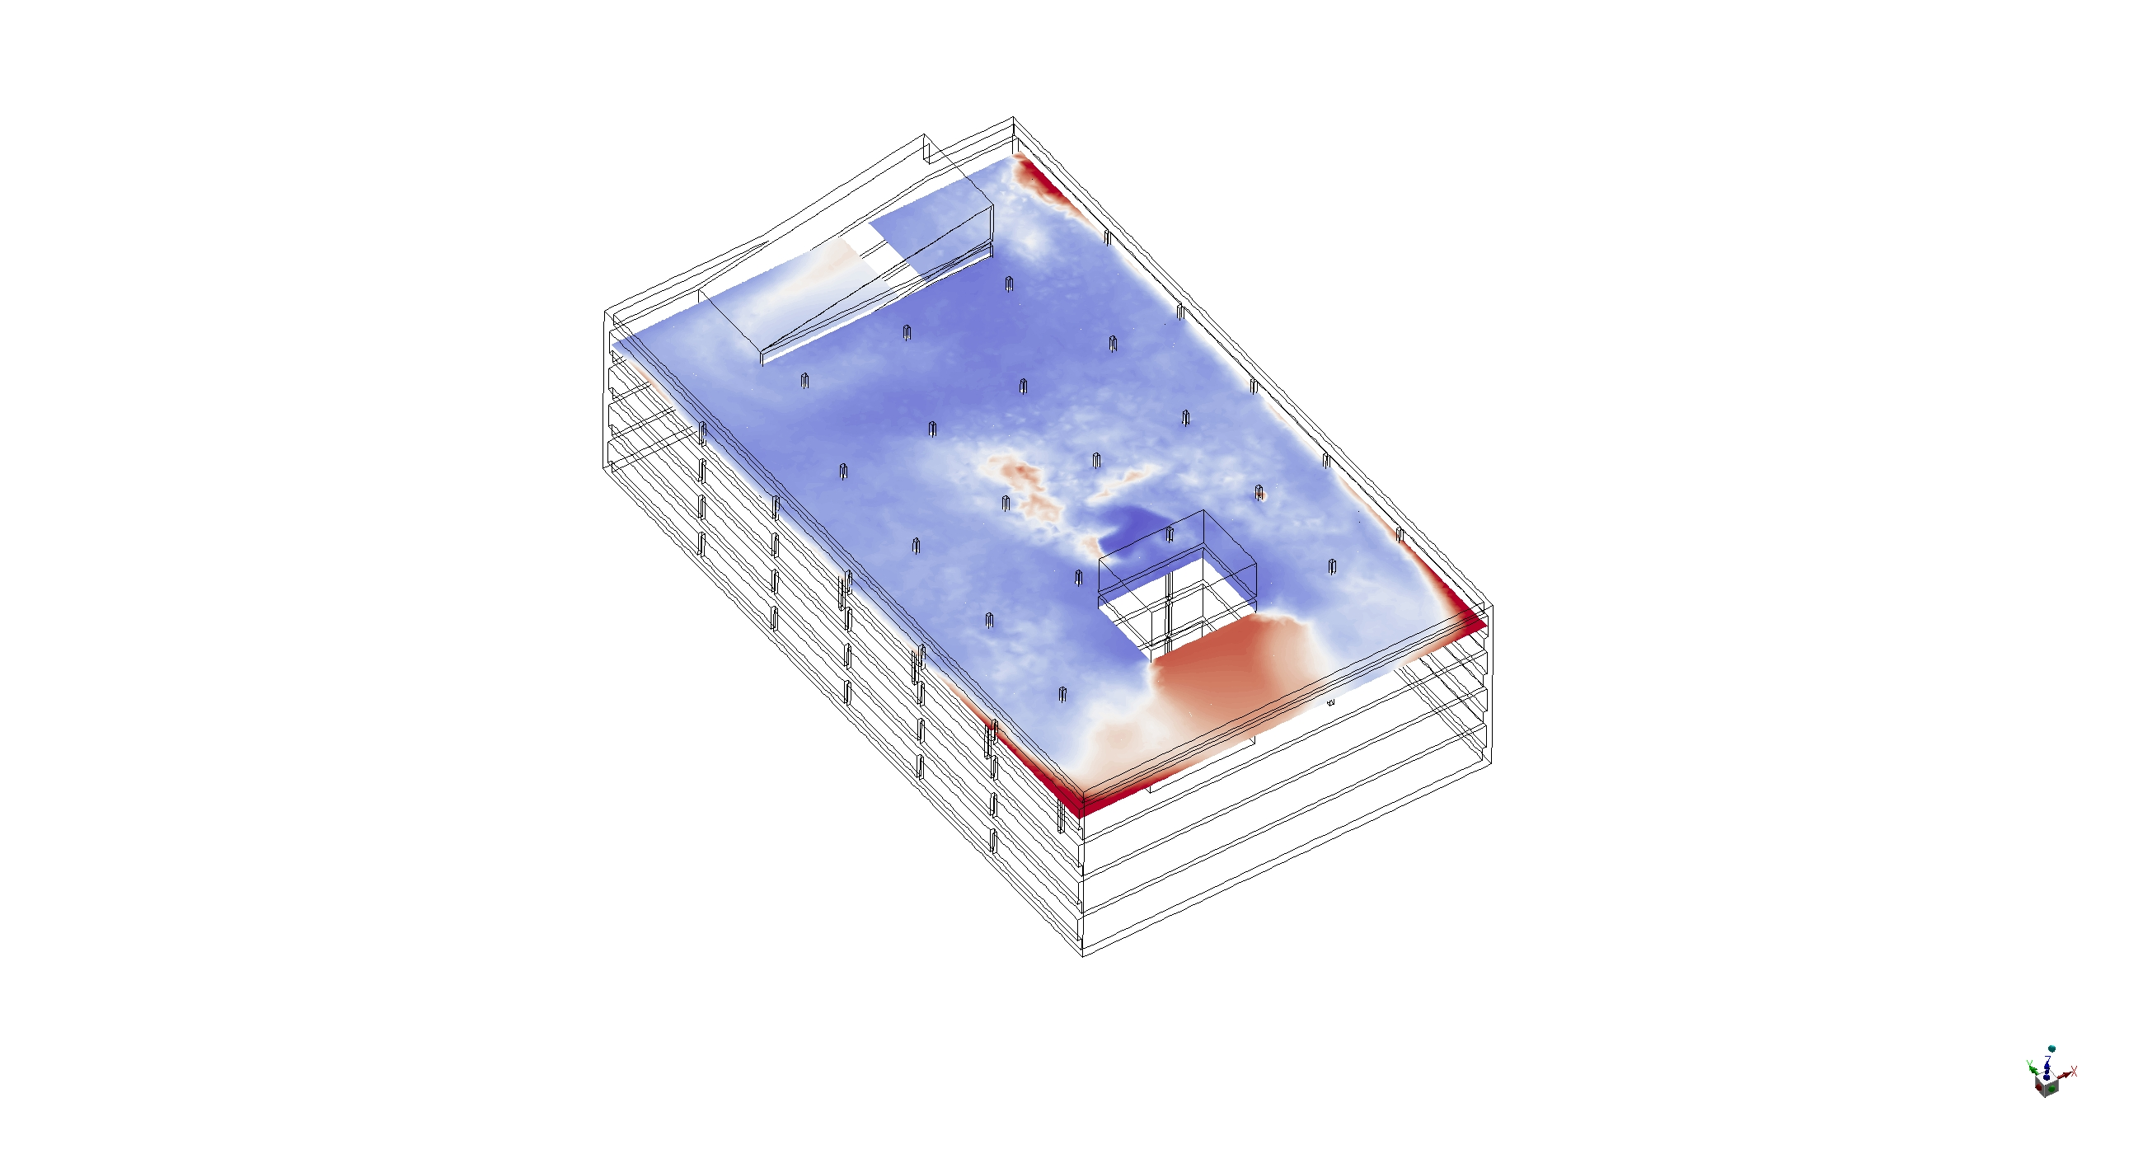
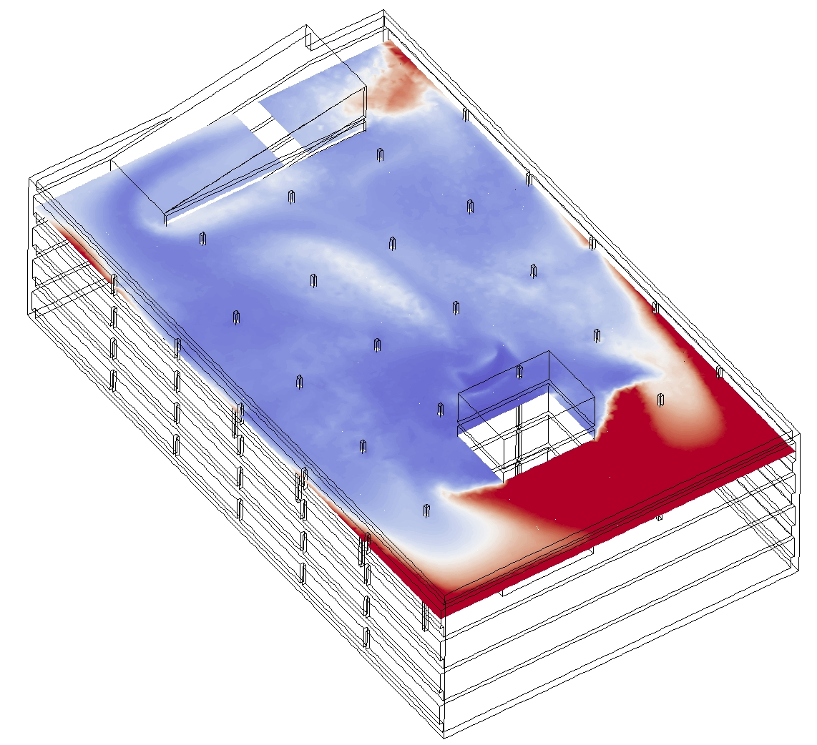
Simulation 4 MW, 270º

Slide 27
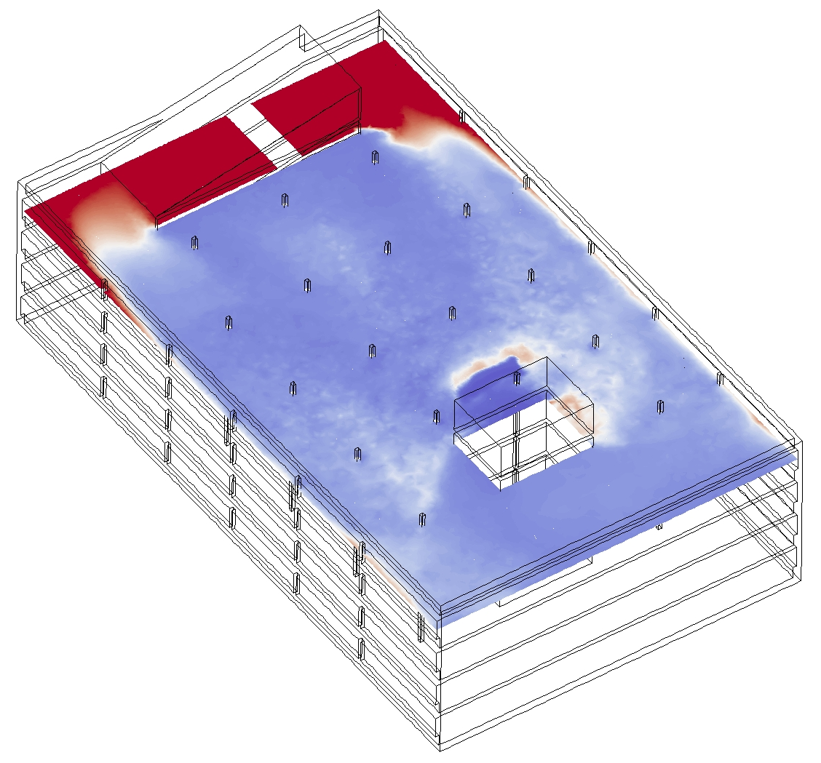
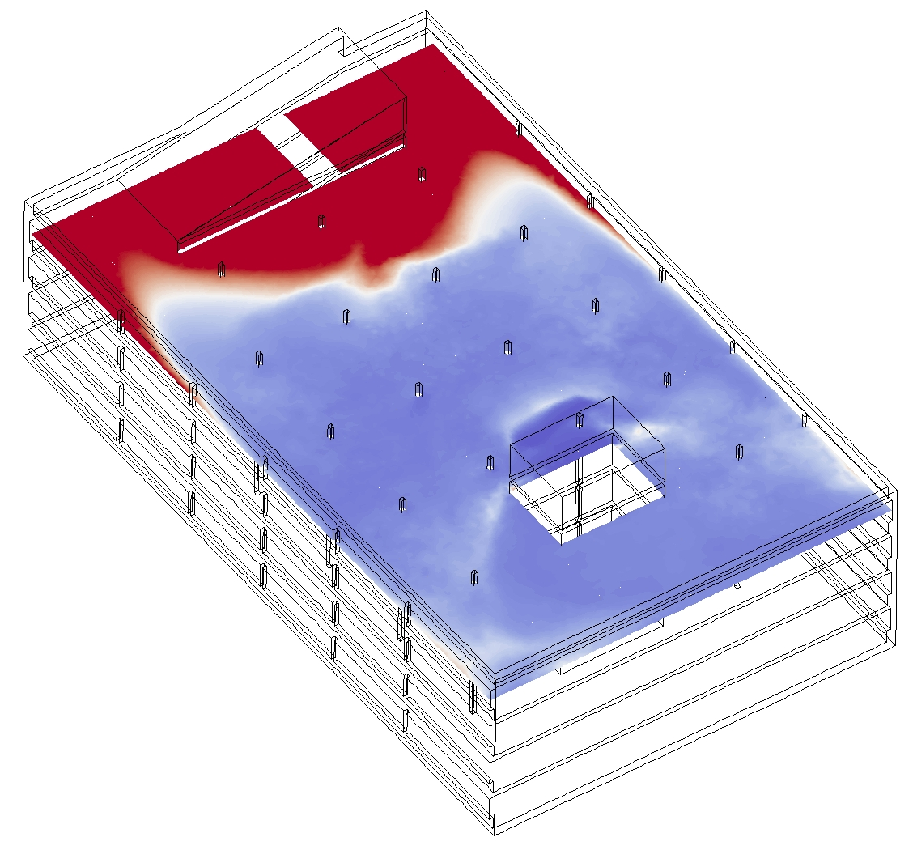
Simulation 4 MW, 90º

Slide 28
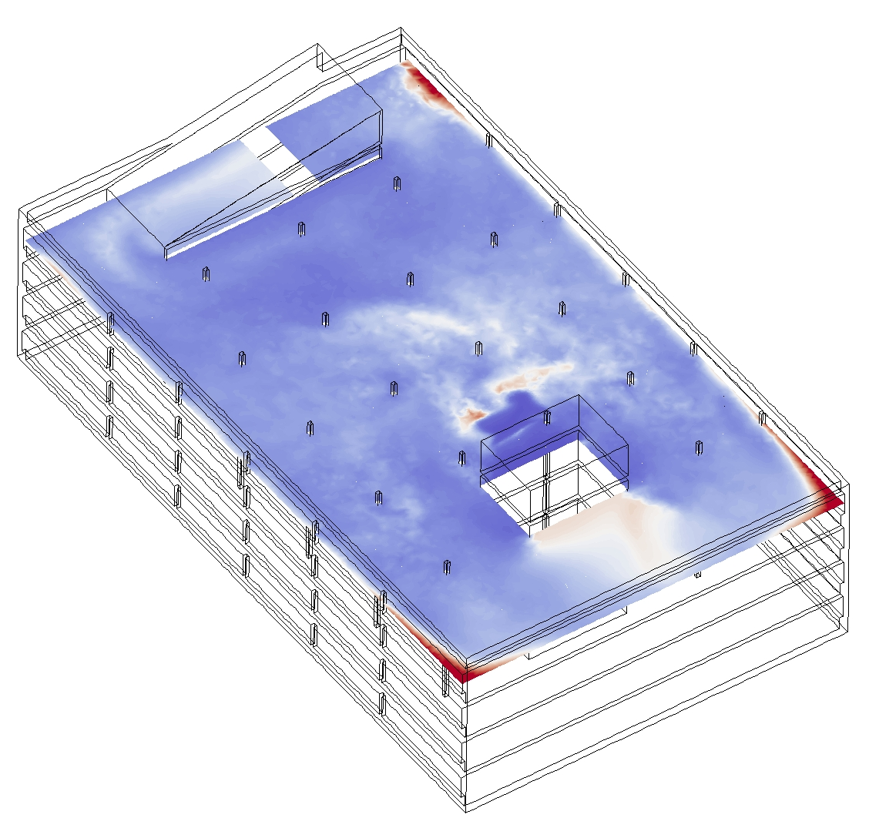
Simulation 3 m/s, 270º

Slide 29
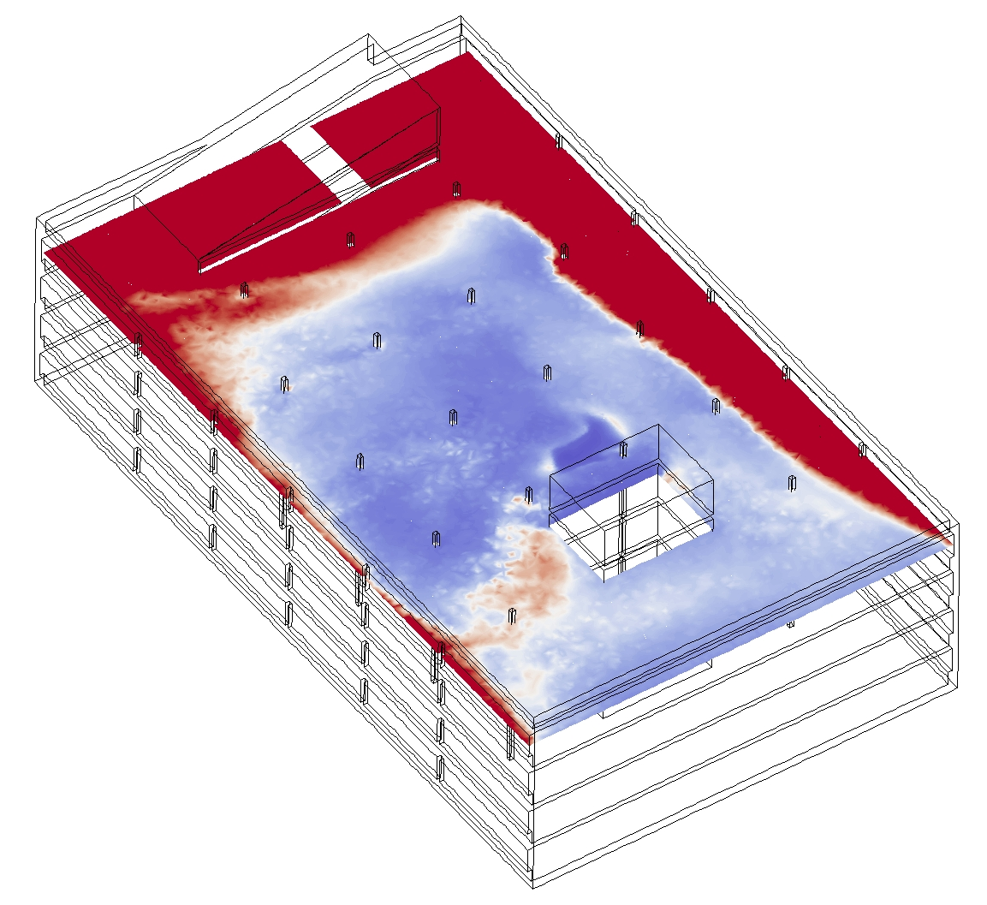
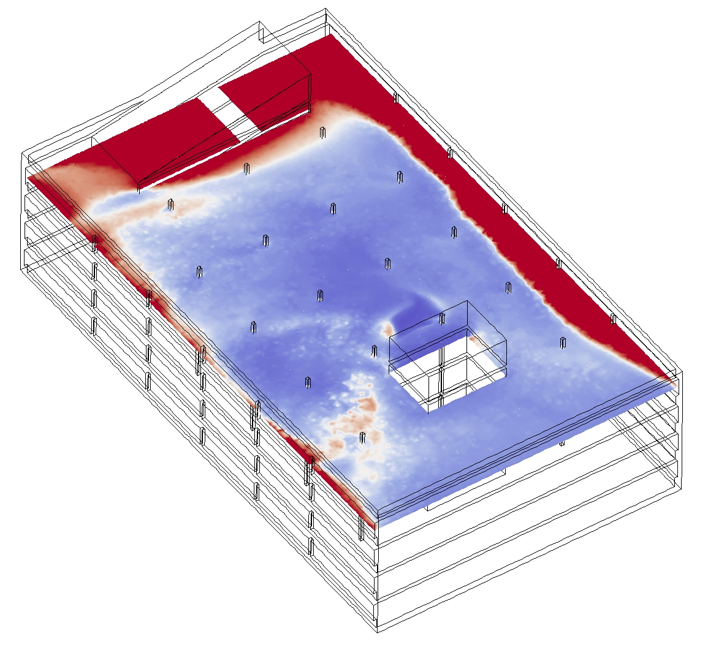
Simulation 3 m/s, 120º

Slide 30
Next step: validation

Slide 31
Thank you for your attention!
Any questions?

