Slide 1





Inert Wall Exposed to Fire – Experiment and FDS Model
UNIVERSITY OF CHEMISTRY AND TECHNOLOGY
Department of Chemical Engineering
Laboratory of Fire Engineering
Vojtěch Šálek, Lucie Hasalová, Petr Hejtmánek
Supported by the Ministry of Interior, Safety research programme of the Czech Republic 2015–2022 (BV III/I - VS) under number VI20192022120 – Fire development modelling of engineered wood and by Specific university research grant No A1_FCHI_2022_005.

Slide 2
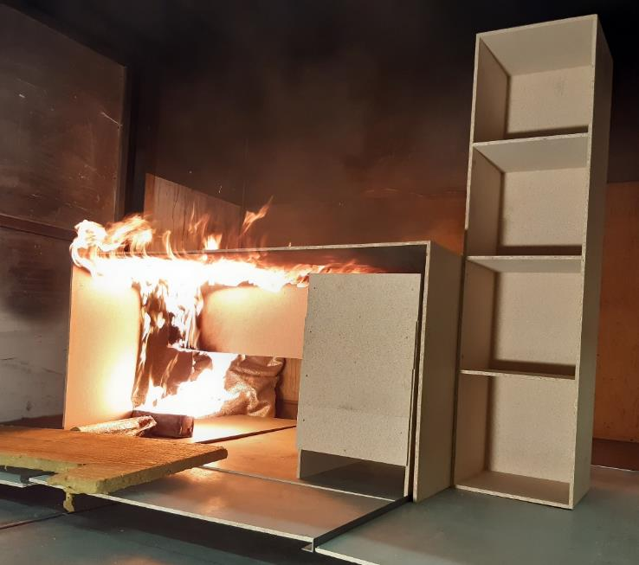
Motivation – fire spread modeling
Engineered Wood Products
(OSB, MDF, plywood,..)
CFD coupled to pyrolysis model
Complex modeling parameters
Pyr. gas composition
Soot yield
Density
Heat conductivity
Specific heat
Emissivity
Char density
Char heat cond.
Char specific heat
Char emissivity
Preexp. factor
Activation energy
Order of reaction
Heat of reaction
Heat of combustion
Stoch. coeff. of char
Stoch. coeff. of decomposing comp.

Slide 3
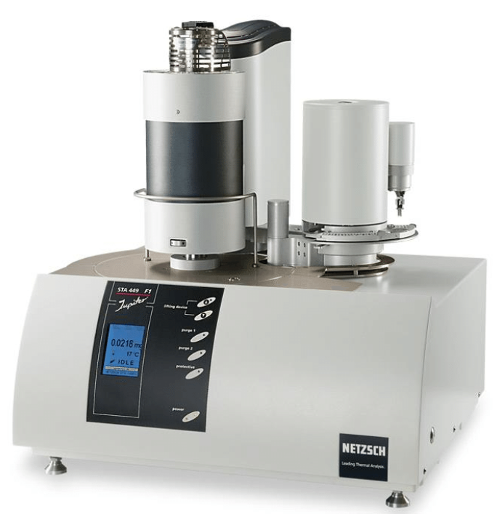
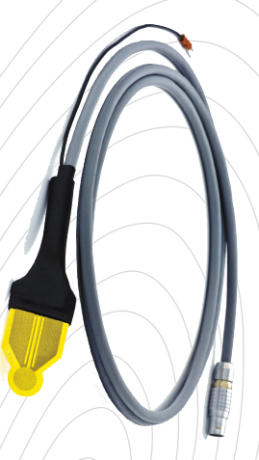
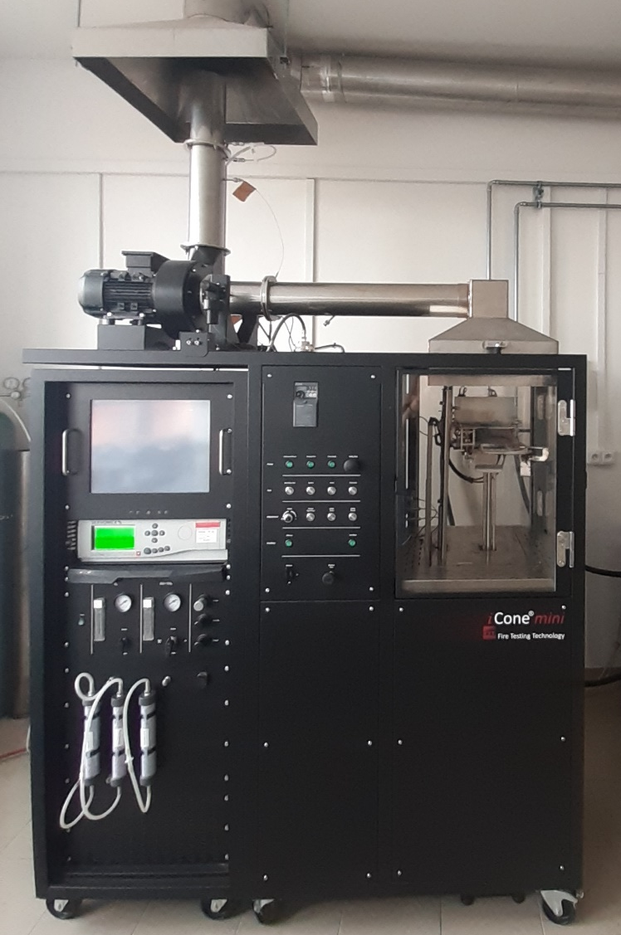
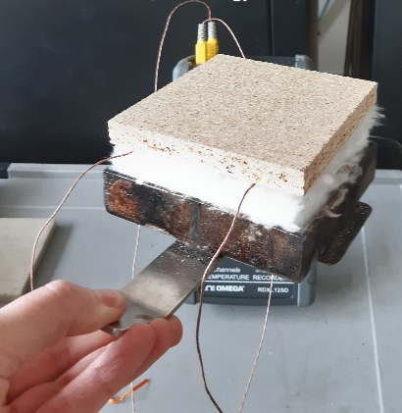
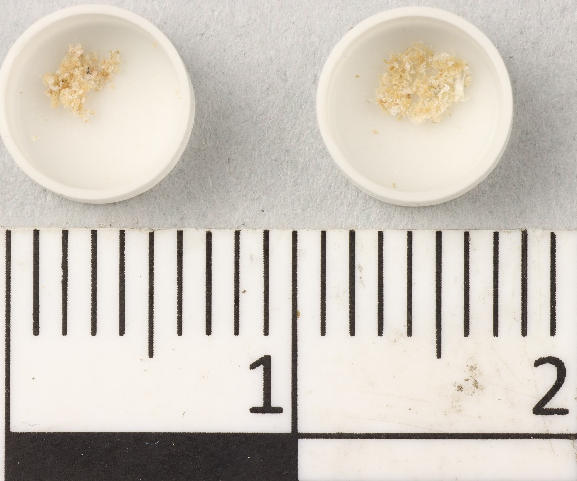
Pyrolysis model input parameters
Micro-scale (TGA, DSC)
Bench-scale (Cone, Hot Disk)

Slide 4
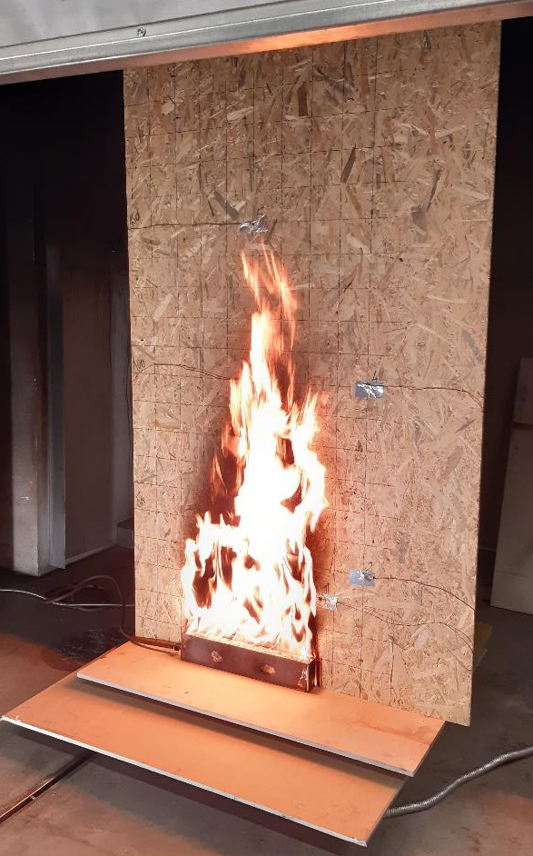
Validation of pyrolysis model
Vertical flame spread experiment
  Dataset covering flame spread
  2 x 1 m board
  50 x 5 x 10 cm propane burner
Combustible wall fire model
  Turbulent buoyant fluid model
  Gas phase kinetics
  Flame heat transfer
  Pyrolysis
Discrepancy related to pyrolysis only?
Wong, William Chiu-Kit. 2012. CFD Flame Spread Model Validation: Multi-Component Data Set Framework. : Worcester Polytechnic Institute

Slide 5
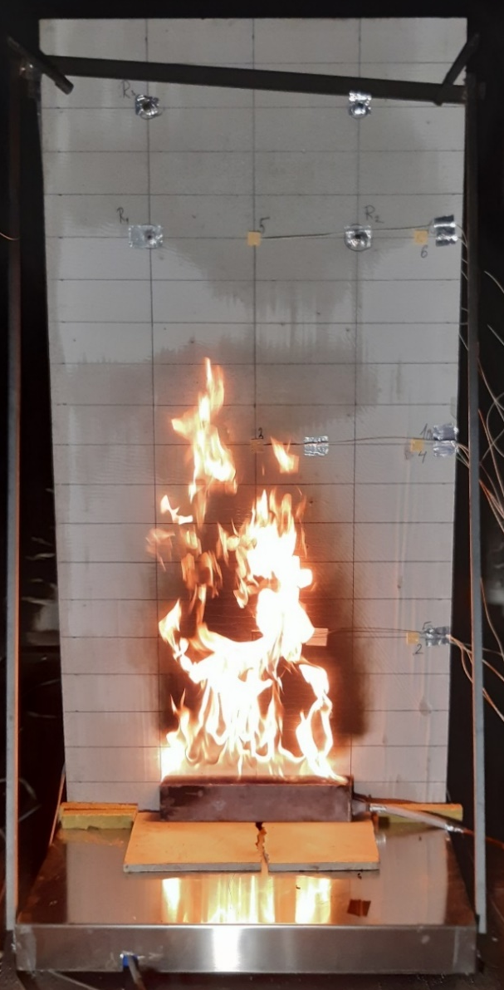
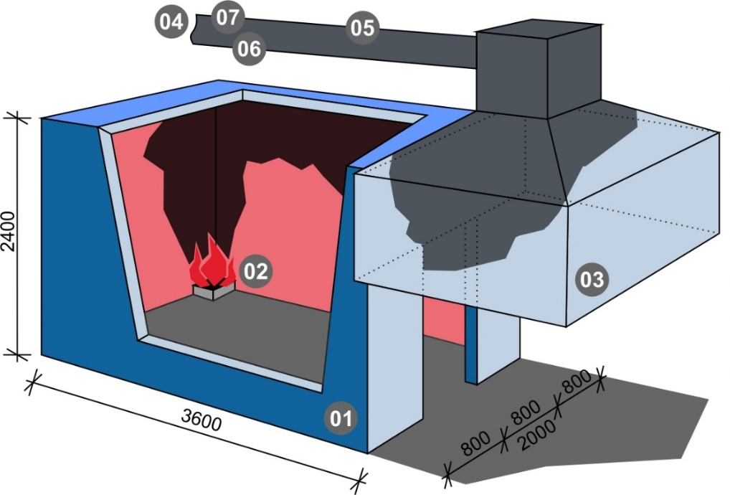
Inert wall fire
Thermal feedback to the wall
Fiber cement panel
  2 x 1 m
  12 mm thick
  Back side exposed

Slide 6
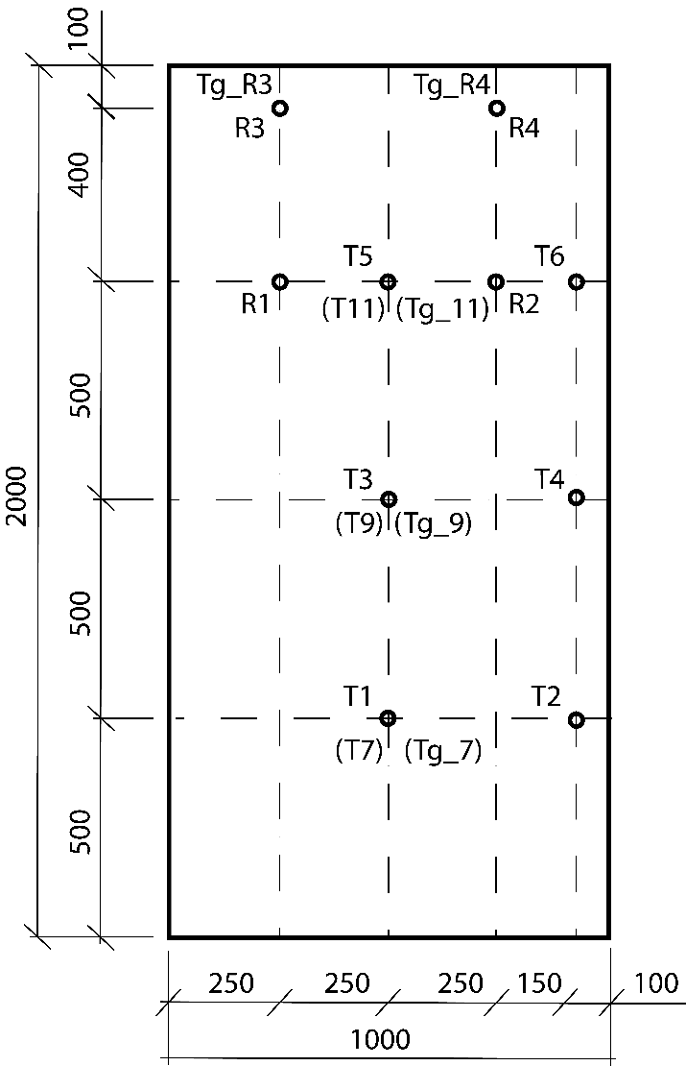
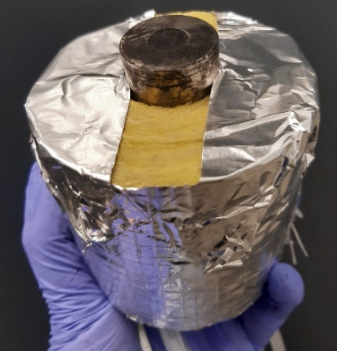
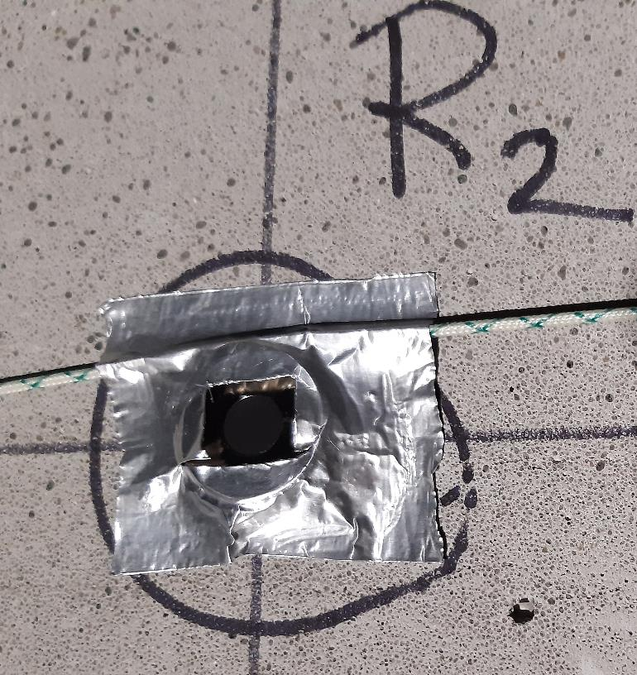
Inert wall measured quantities
Gas phase
  Temperature in the corner
  Temperature close to the panel
  Net heat flux to the wall
Solid phase
  Surface temperature front and back

Slide 7
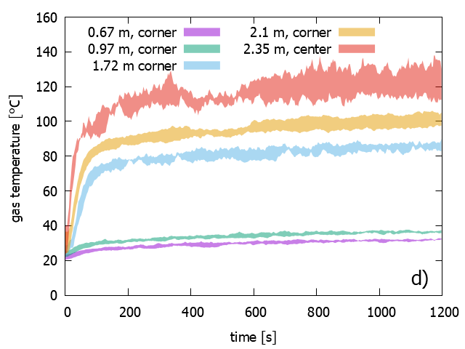
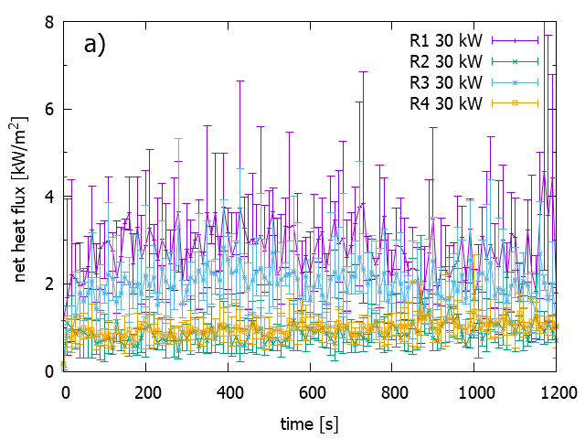
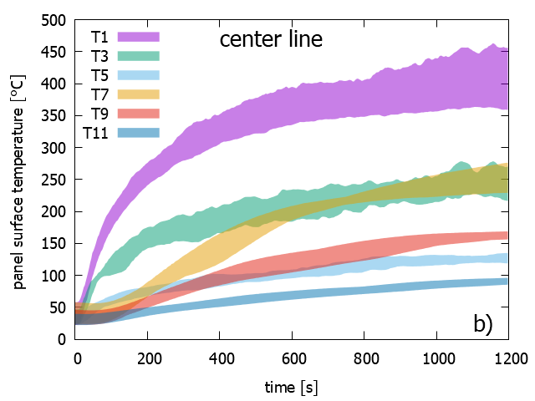
Repeatability and uncertainty
5 times at each heat flux (30 and 50 kW)
Max-min values showed for 30 kW
  25 °C ± 2.5 °C
Net heat flux
    Calibration accuracy is ± 3 % at full scale
    Non-linearity error 10 - 50 %
  90 °C ± 3.8 °C

Slide 8
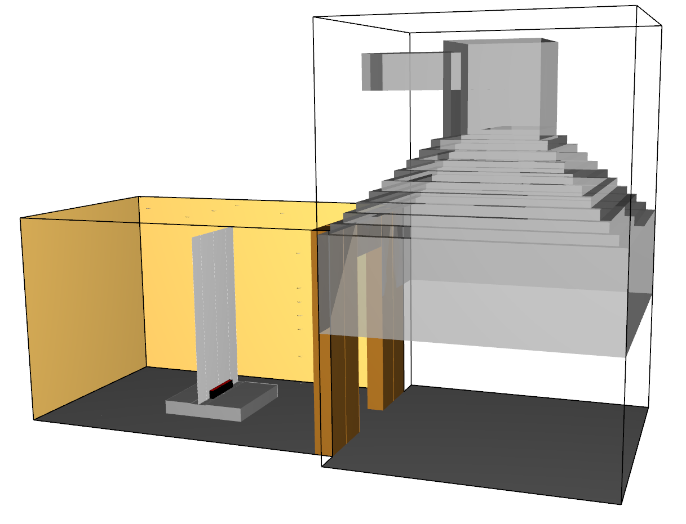
Model
FDS (Fire Dynamic Simulator) ver. 6.7.7
Layout (ISO 9705-1) modified according to experiments

Slide 9

Model – boundary conditions
&SURF ID='VENTILATOR',
VOLUME_FLOW=0.8 / (m³/s)
&VENT SURF_ID='OPEN'/
&OBST SURF_ID='INERT', TRANSPARENCY=0.5 /
&MATL ID=‚AERATED_CONCRETE',
SPECIFIC_HEAT=1.0,
CONDUCTIVITY=0.12,
DENSITY=500.0/
&SURF ID=‚FLOOR',
BACKING='VOID',
MATL_ID(1,1)=' AERATED_CONCRETE ',
MATL_MASS_FRACTION(1,1)=1.0,
THICKNESS(1)=0.1,/

Slide 10
Model – boundary conditions
&SURF ID=‚CEILING',
COLOR='BLACK',
BACKING='VOID',
MATL_ID(1,1)='FERMACELL_AESTUVER',
MATL_ID(2,1)='MINERAL_WOOL',
MATL_ID(3,1)='YTONG',
THICKNESS(1)=0.020,
THICKNESS(2)=0.030,
THICKNESS(3)=0.2, /
&MATL ID='YTONG',
SPECIFIC_HEAT=1.0,
CONDUCTIVITY=0.10,
DENSITY=400.0/
&MATL ID='FERMACELL_AESTUVER',
SPECIFIC_HEAT=0.9,
CONDUCTIVITY=0.21,
DENSITY=800.0 /
&MATL ID='MINERAL_WOOL',
SPECIFIC_HEAT=0.94,
CONDUCTIVITY=0.035,
DENSITY=35.0 /

Slide 11
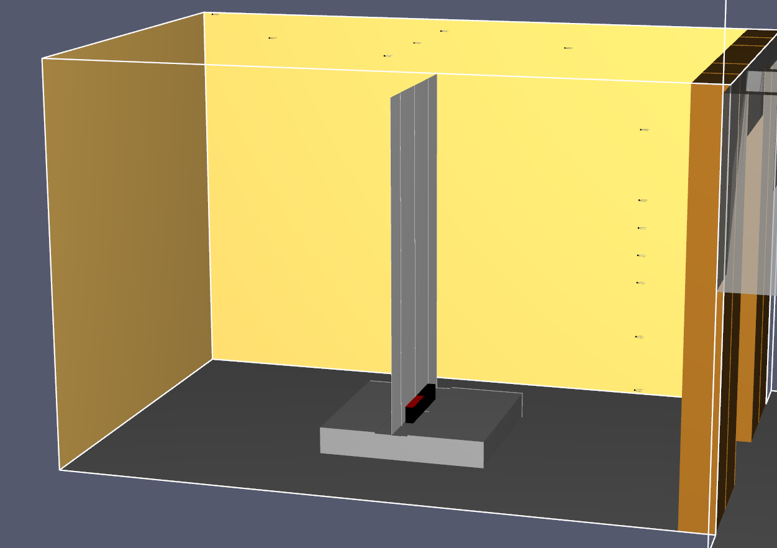
Model – boundary conditions
Inert wall
2 x 1 x 0,0125 m
Burner (30 kW)
50 x 5 x 10 cm
&SURF ID='INERT_WALL',
COLOR='WHITE',
BACKING='EXPOSED',
MATL_ID(1,1)=
'FERMACELL_POWERPANEL',
MATL_MASS_FRACTION(1,1)=1.0,
STRETCH_FACTOR(1)=1,
CELL_SIZE_FACTOR=0.5,
THICKNESS(1)=0.0125 /
&SURF ID='BURNER',
COLOR='RED'
HRRPUA=1200.0 /
&MATL ID=
'FERMACELL_POWERPANEL',
SPECIFIC_HEAT=1.0,
CONDUCTIVITY=0.17,
DENSITY=1000.0 /

Slide 12
Model – inert wall
&SURF ID='INERT_WALL',
COLOR='WHITE',
BACKING='EXPOSED',
MATL_ID(1,1)=
'FERMACELL_POWERPANEL',
MATL_MASS_FRACTION(1,1)=1.0,
STRETCH_FACTOR(1)=1,
CELL_SIZE_FACTOR=0.5,
THICKNESS(1)=0.0125 /
BACKING='EXPOSED'
  Influences heat conduction
  Maximum one cell thick objects

Slide 13



Model – inert wall
&SURF ID='INERT_WALL',
COLOR='WHITE',
BACKING='EXPOSED',
MATL_ID(1,1)=
'FERMACELL_POWERPANEL',
MATL_MASS_FRACTION(1,1)=1.0,
STRETCH_FACTOR(1)=1,
CELL_SIZE_FACTOR=0.5,
THICKNESS(1)=0.0125 /
BACKING='EXPOSED'
  Influences heat conduction
  Maximum one cell thick objects

Slide 14
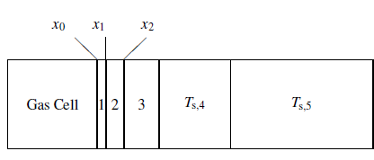
Model – inert wall
&SURF ID='INERT_WALL',
COLOR='WHITE',
BACKING='EXPOSED',
MATL_ID(1,1)=
'FERMACELL_POWERPANEL',
MATL_MASS_FRACTION(1,1)=1.0,
STRETCH_FACTOR(1)=1,
CELL_SIZE_FACTOR=0.5,
THICKNESS(1)=0.0125 /
BACKING='EXPOSED'
  Influences heat conduction
  Maximum one cell thick objects

Slide 15

Model – inert wall
&SURF ID='INERT_WALL',
COLOR='WHITE',
BACKING='EXPOSED',
MATL_ID(1,1)=
'FERMACELL_POWERPANEL',
MATL_MASS_FRACTION(1,1)=1.0,
STRETCH_FACTOR(1)=1,
CELL_SIZE_FACTOR=0.5,
THICKNESS(1)=0.0125 /
First cell size calculated as
$\sqrt{tk_{s}/ρc_{s}}$
Number and size of additional cells
  Default:
    stretch factor = 2 (x times previous cell)
    cell size factor = 1 (x times first cell)

Slide 16
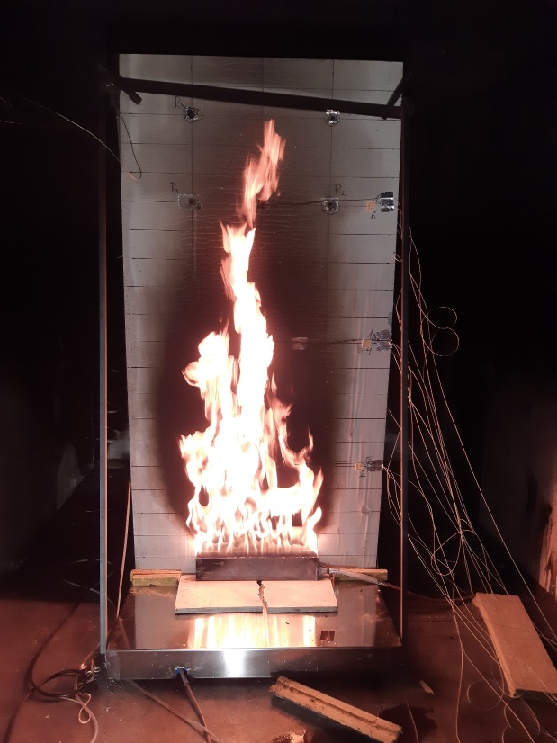
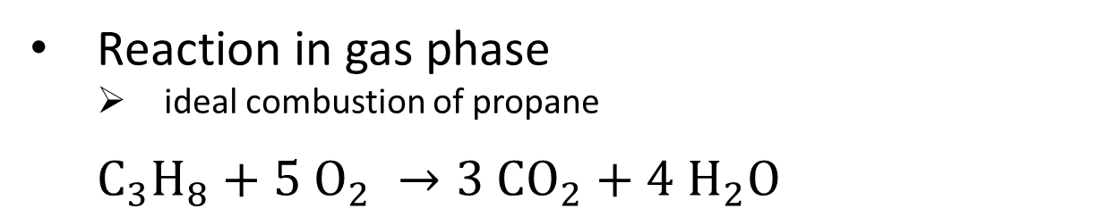
Model – combustion
Reaction in gas phase
  ideal combustion of propane
  $C_{3}H_{8}+5{ O}_{2} →3 CO_{2}+4{ H}_{2}O$
&REAC ID='PROPANE',
FUEL='PROPANE',
SOOT_YIELD=0.0
CO_YIELD=0.0 /
  No soot formation assumed

Slide 17


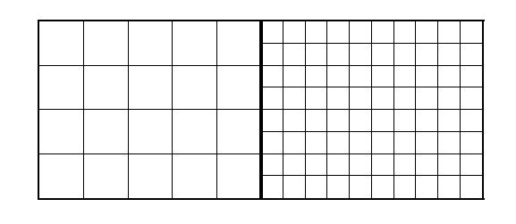
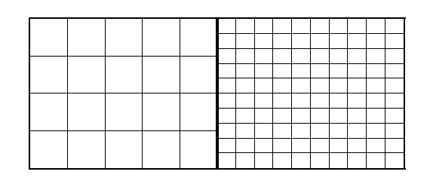
Model – computational mesh
Computational mesh analysis is basic assumption for good model prediction
Cell size necessary to solve boundary layer and temperature gradient in the wall is in order of 1 mm [1]
  Extreme computational demands
  FDS restricted to structured meshes
  ~ 800 000 cells/mesh
[1] Brown, A., Bruns, M., Gollner, M., Hewson, J., Maragkos, G., Marshall, A., McDermott, R., Merci, B., Rogaume, T., Stoliarov, S., Torero, J., Trouvé, A., Wang, Y., Weckman, E. (2018). Proceedings of the First Workshop Organized by the IAFSS Working Group on Measurement and Computation of Fire Phenomena (MaCFP), Fire Safety Journal, 101, 1-17.

Slide 18
Model – computational mesh
Restrictions in burner size, distance from burner to wall and conditions of „backing“
Large jumps between individual
Near wall vs. far from wall
Model label | Cell size in direction perpendicular to the panel | Total number of cells | Number of meshes | Simulation time (s)
1 mm | 1 mm – 2 mm - 4 mm – 2 cm | 65 902 500 | 80 | 10 s
2 mm | 2 mm - 4 mm - 8 mm – 4 cm | 22 222 800 | 36 | 40 s
2 cm | 1 cm – 2 cm - 10 cm | 804 084 | 11 | 600 s
5 cm | 1 cm - 5 cm | 1 070 496 | 6 | 600 s
10 cm | 1 cm - 10 cm | 637 812 | 6 | 600 s

Slide 19
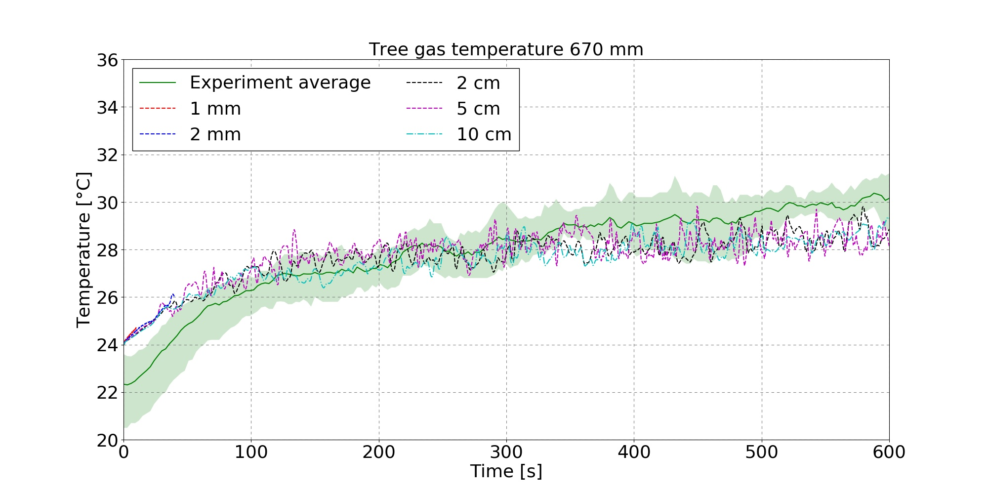
Results – cold layer 670 mm

Slide 20
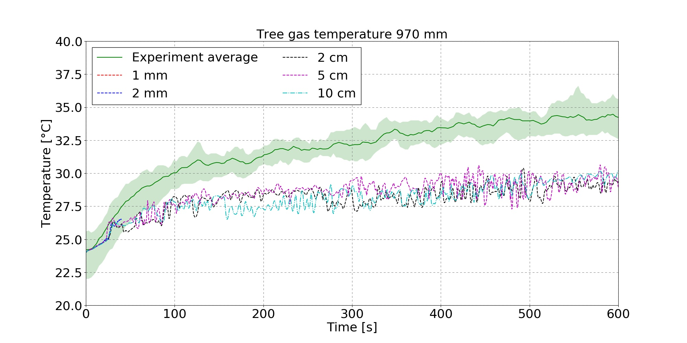

Results – cold layer 970 mm
  Δ $\sim$ 5 °C $\sim$ 15 %
Both height 670 and 970 mm safely in cold layer
Independent of mesh density

Slide 21
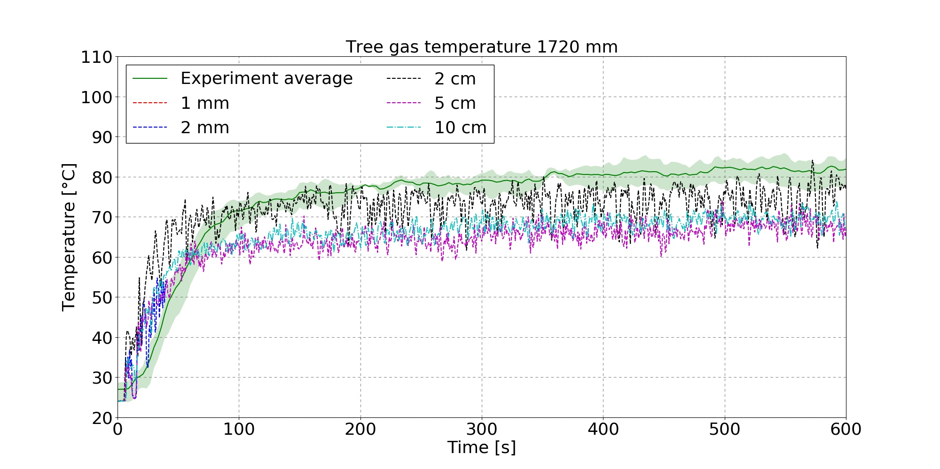

Results – hot layer 1720 mm
  Δ $\sim$ 10 °C $\sim$ 12.5 %

Slide 22
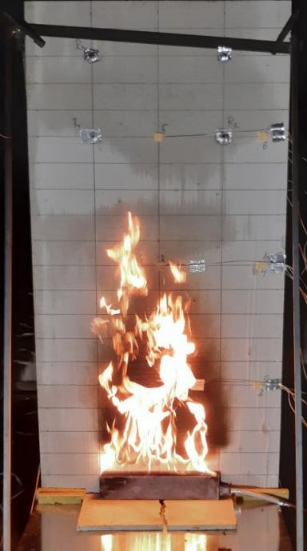
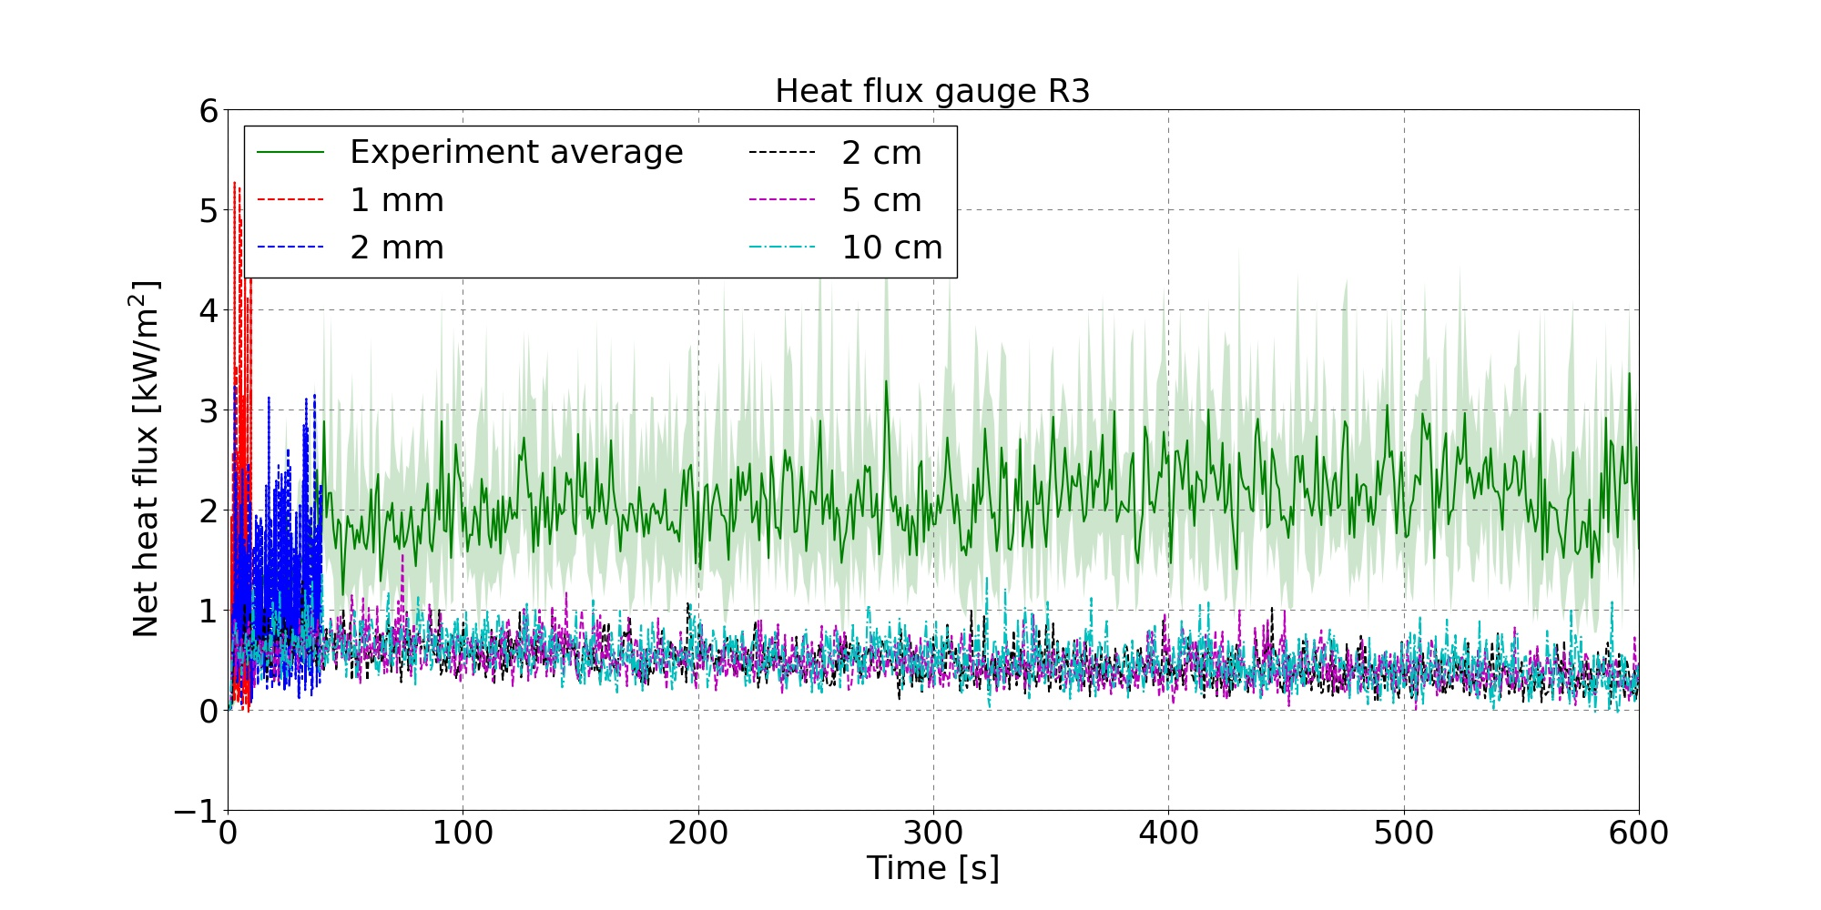
Results – heat flux to the wall
Significantly higher scatter of values for milimeter size meshes

Slide 23
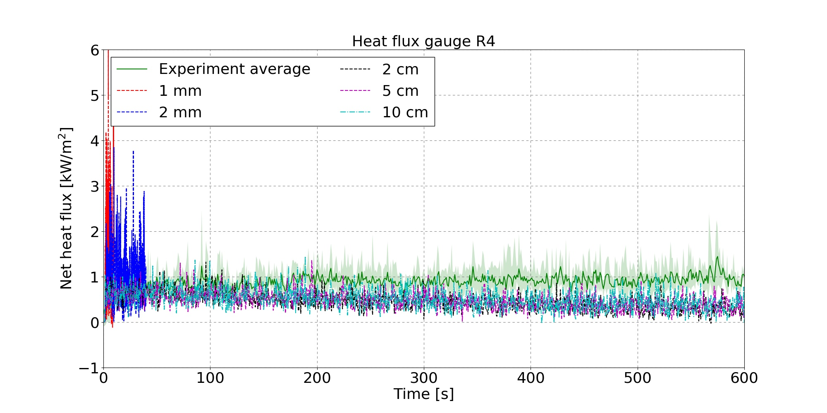
Results – heat flux to the wall
Symetrical model behaviour compared to experiment
Net heat flux measured, radiometer is cooled compared to wall

Slide 24
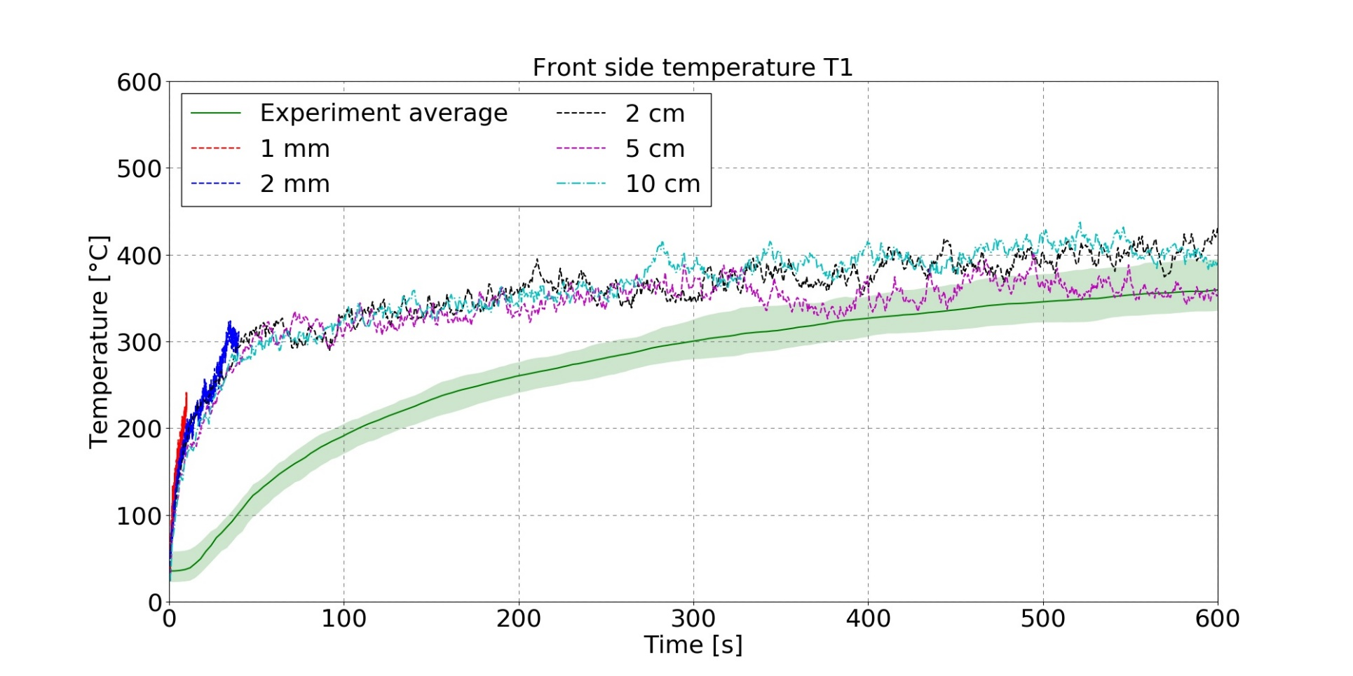
Results – center surface temperature
Mesh density has no influence
Moisture
Constant k and c_{p}

Slide 25
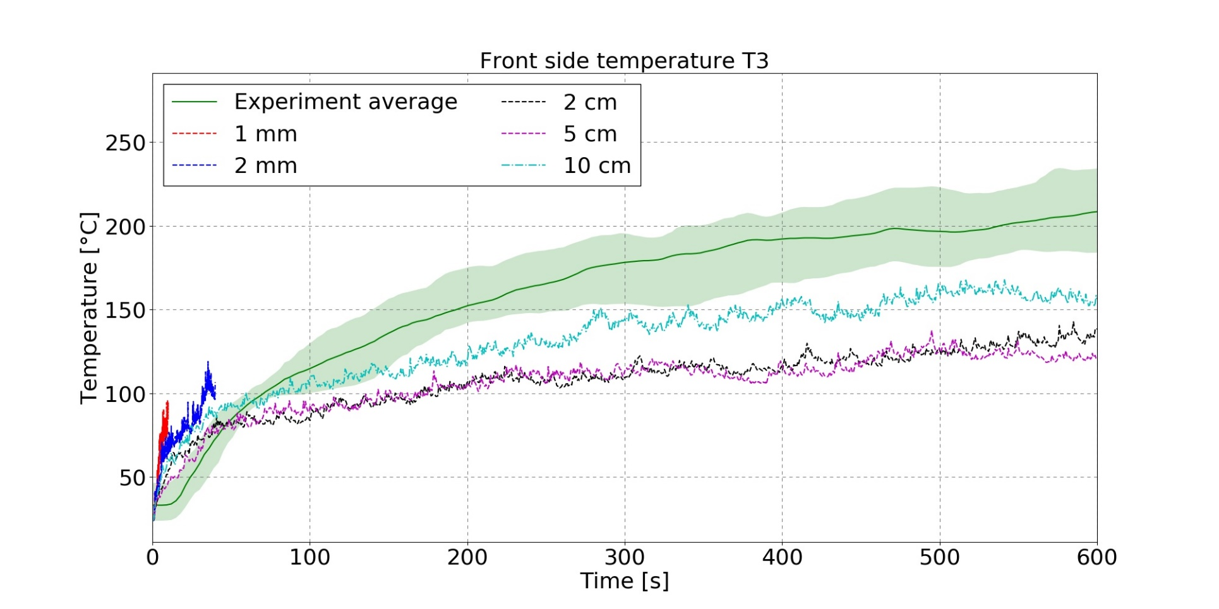
Results – center surface temperature
Moisture, constant k and c_{p}
Mesh density has an influence
1D heat transfer

Slide 26
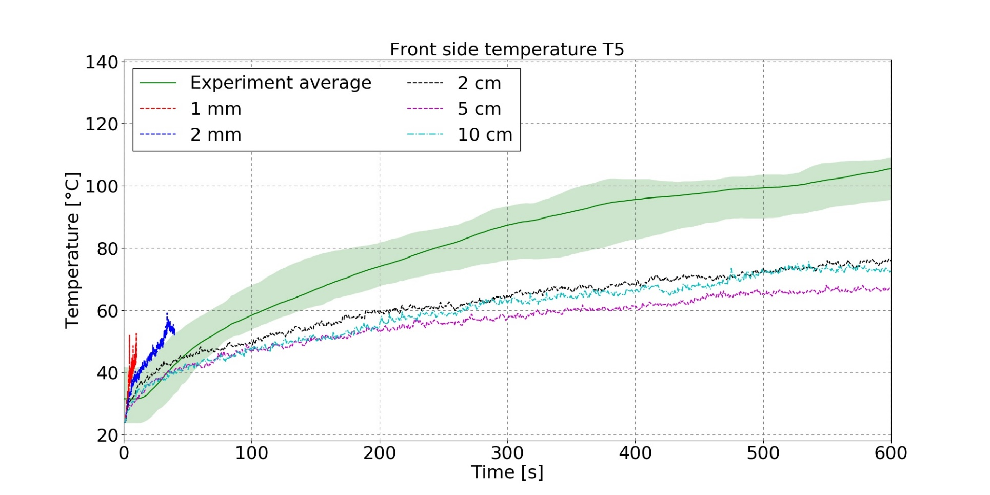
Results – center surface temperature
Moisture, constant k and c_{p}
Mesh density has an influence
1D heat transfer

Slide 27
Conclusions
A lot of work to do in the future
Experiments
  Use heat flux gauges with lower measuring range
  Measure velocity profile in the doors
Model
  Need of milimeter-size mesh confirmed
  Change the boundary condition in the hood area
  Add temperature dependent parameters
  The effect of 3D conduction
  Get at least 200 seconds of the very fine meshes

Slide 28
Thank you for you attention!

